Slide 1
ERF System Introduction
A guided walkthrough for expense filers and approving managers
Notes:
Welcome to the ERF System tutorial. I’ll show you how to create, file, approve, and review an expense report. Follow each screen in order, and pause whenever you need more time.

Slide 2
WORKFLOW OVERVIEW
The ERF workflow moves from setup to filing and approval
1
2
3
4
5
Sign in
Prepare
Create
File
Finish
Access the ERF System with your assigned credentials.
Review account, email, password, and signatory settings.
Enter expense details and confirm the report output.
Submit the report for manager review and approval.
Send or print the completed expense report.
Employees prepare and file. Managers review and decide.
2
Notes:
The process starts with account setup and expense entry. The report is then filed, reviewed by the manager, and checked by Finance. Let’s go through each step.

Slide 3
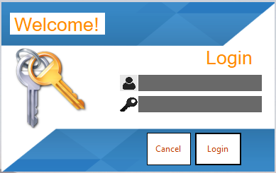
EMPLOYEE
Start by signing in to the ERF System
WHAT TO DO
1
Enter your assigned username.
2
Enter your password.
3
Select Login to continue.
3
Notes:
Enter your username and password. Check that both are correct, then click Login. Use Cancel if you want to close the window.

Slide 4
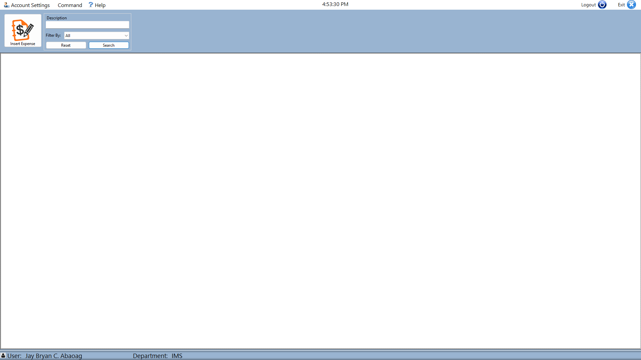
EMPLOYEE
The main page is the starting point for ERF tasks
WHAT TO DO
1
Confirm the signed-in user.
2
Use the top menu to open a task.
3
Check the status bar for context.
4
Notes:
This is the ERF main page. Confirm your user and department at the bottom of the screen. Use the menu or shortcut buttons at the top to open a task.

Slide 5
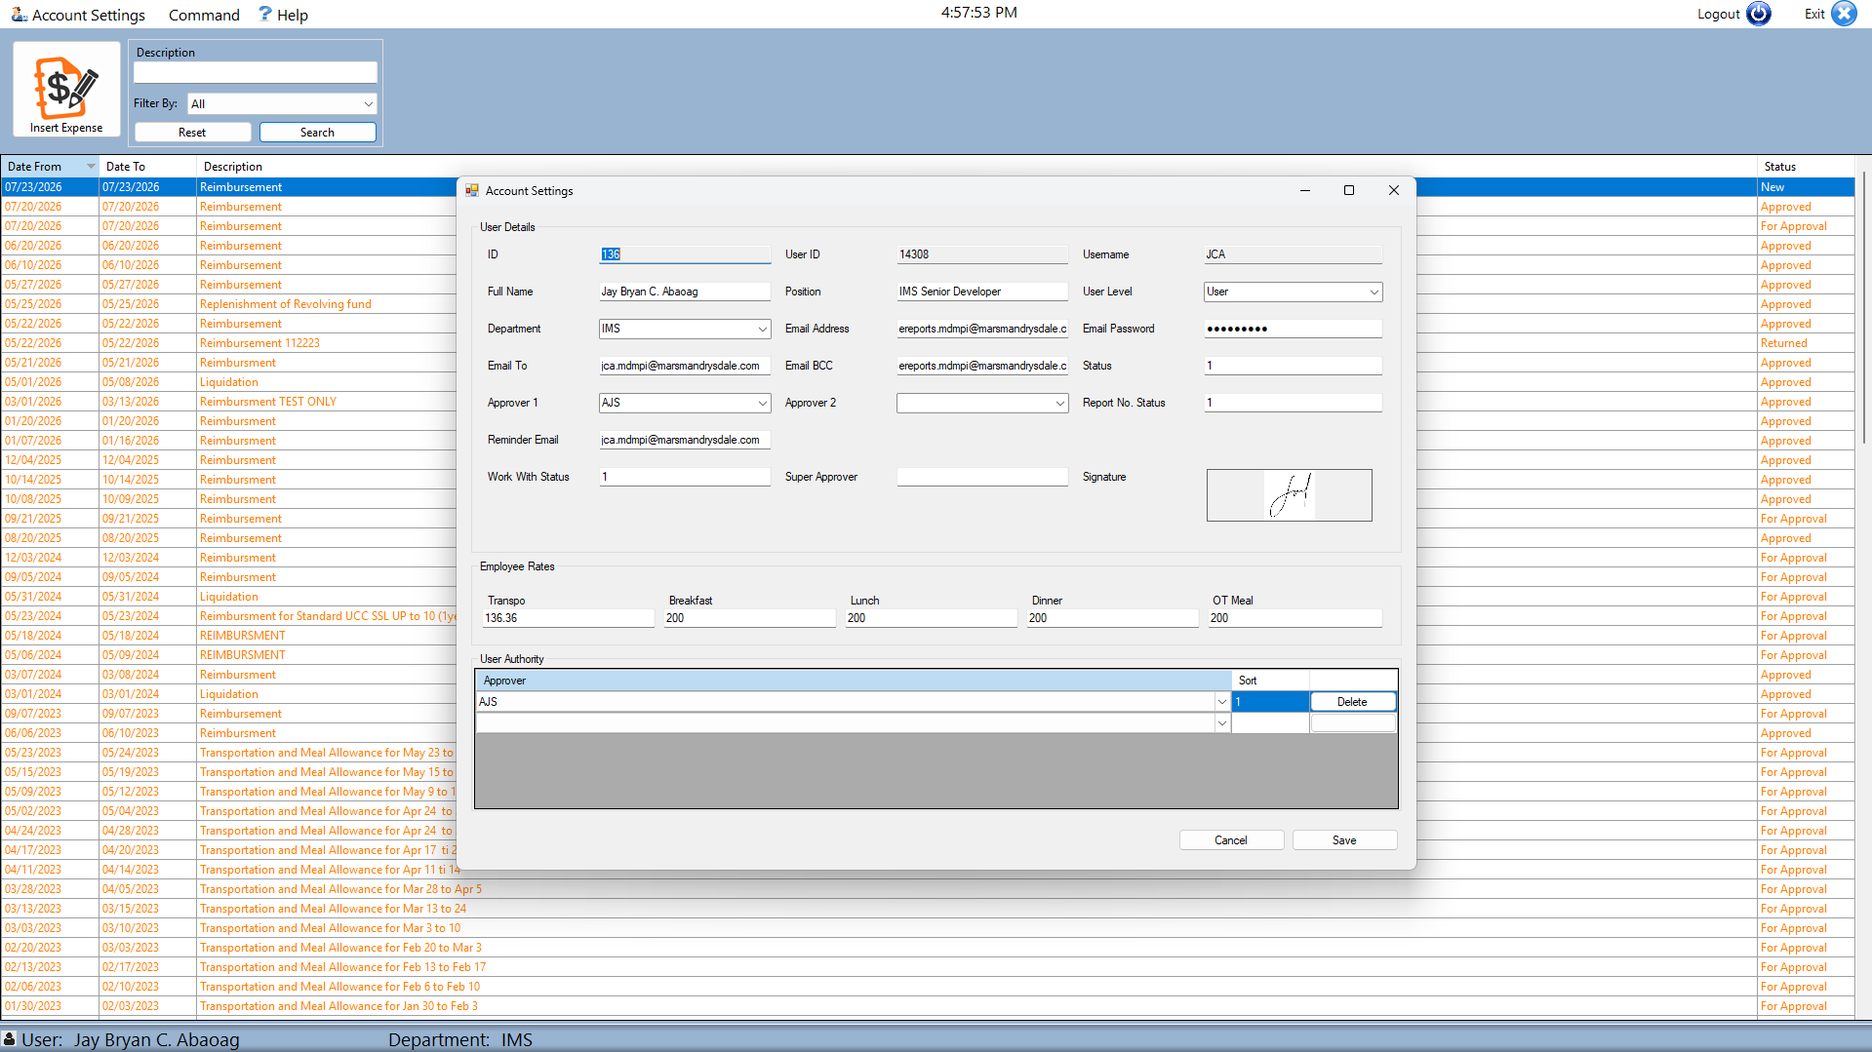
EMPLOYEE
Review account information before filing expenses
WHAT TO DO
1
Open Account Settings.
2
Review your user and employee information.
3
Save only verified changes.
5
Notes:
Open Account Settings and review your information. Update only the fields you are allowed to change. Click Save when the details are correct.

Slide 6
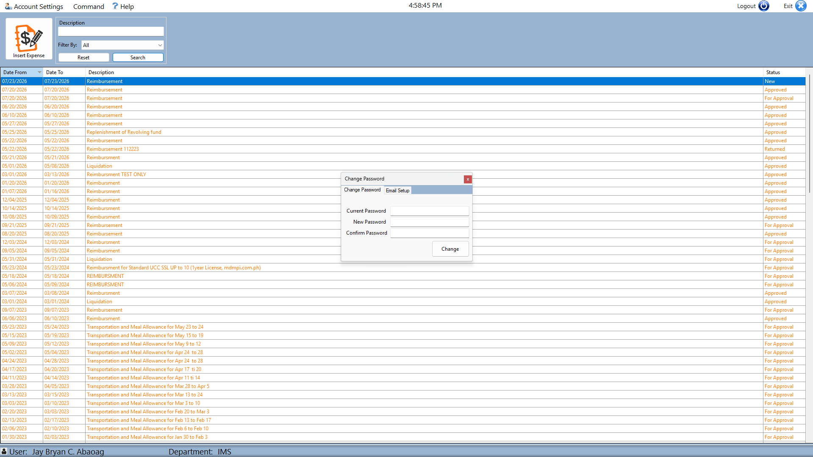
EMPLOYEE
Maintain your password and email configuration
WHAT TO DO
1
Use Change Password when credentials must be updated.
2
Open Email Setup for notification settings.
3
Confirm entries before saving.
6
Notes:
Use Change Password to update your login credentials. Open Email Setup to configure your work email. Check the information before saving.

Slide 7
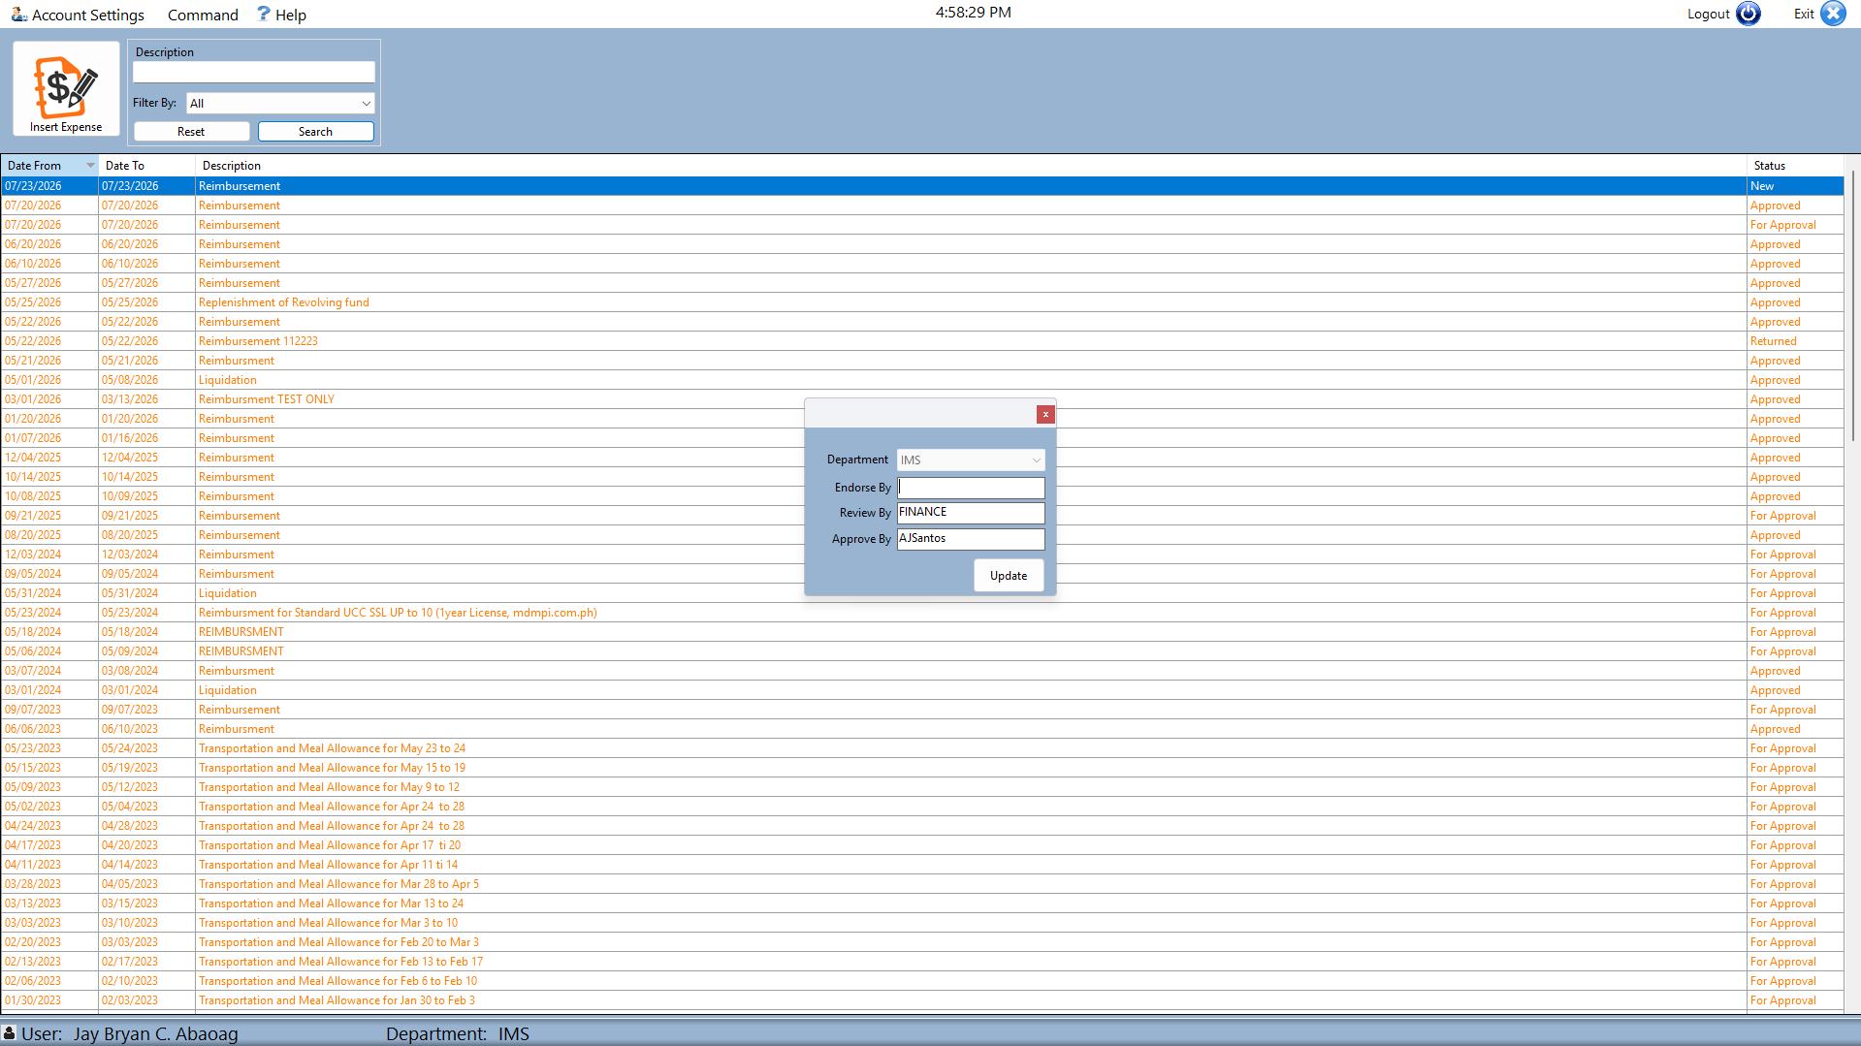
EMPLOYEE
Set the signatory used in the approval route
WHAT TO DO
1
Open the Signatory setup.
2
Select the appropriate approving person.
3
Save the confirmed routing choice.
7
Notes:
Open the Signatory setup and select the correct approver. Check the name before saving because this determines where your report will be sent.

Slide 8
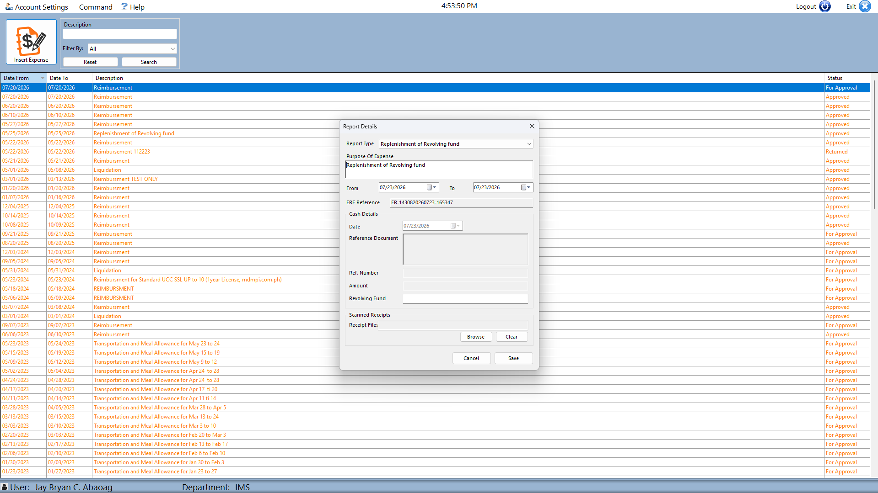
EMPLOYEE
Create a new expense from the main workspace
WHAT TO DO
1
Open the expense entry command.
2
Complete the report header details.
3
Continue to the expense items.
8
Notes:
Open the expense-entry form. Complete the report details using your receipt or supporting documents. Review the information before adding expense items.

Slide 9
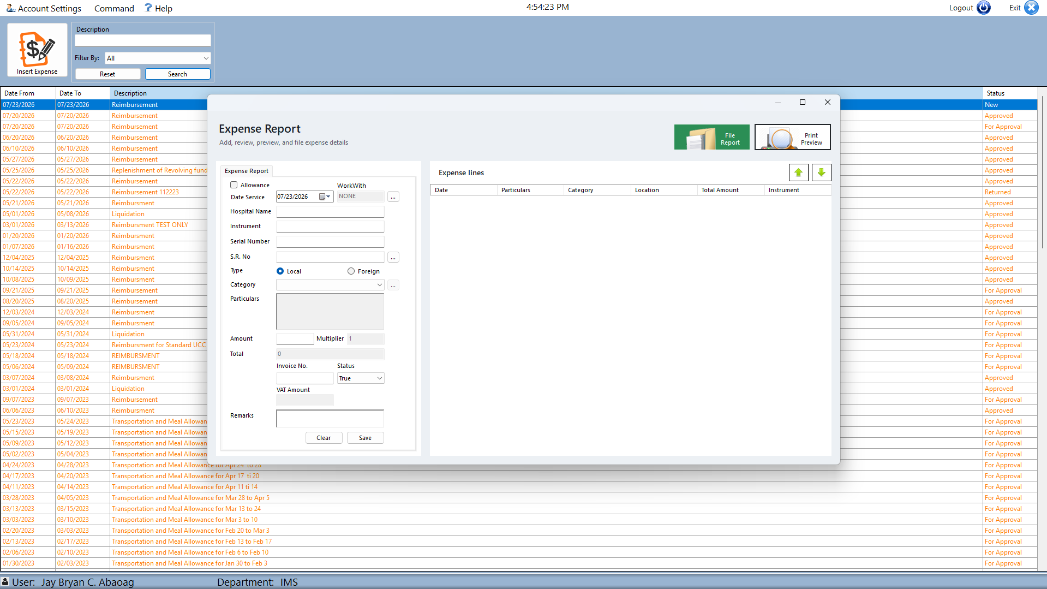
EMPLOYEE
Enter each expense item completely and accurately
WHAT TO DO
1
Add an expense item.
2
Complete the available item fields.
3
Save and review the new line.
9
Notes:
Enter the date, amount, description, and other required details. Compare the entry with the receipt, then click Save. Repeat this step for every expense.

Slide 10
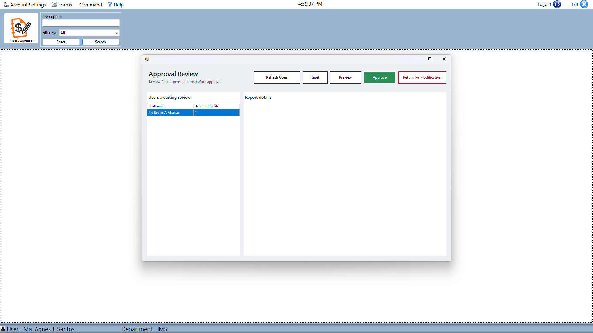
MANAGER
Managers open the approval review queue
WHAT TO DO
1
Open Approval Review.
2
Select a report from the queue.
3
Review the submitted expense details.
10
Notes:
Managers open the Approval Review form and select a report from the list. Check the employee, expense details, and supporting information before taking action.

Slide 11
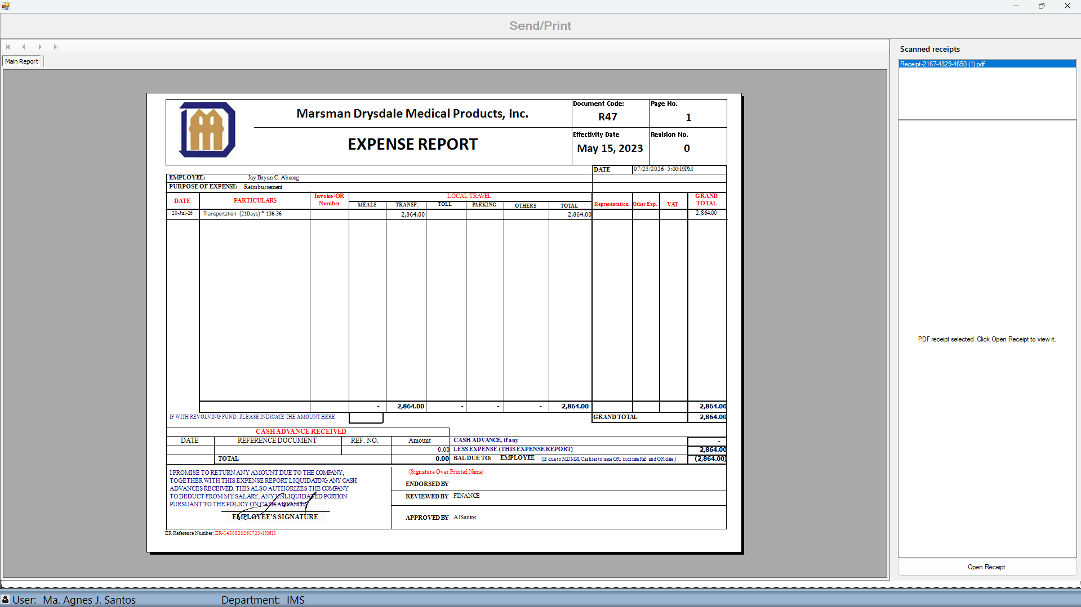
MANAGER
Record the approval decision after completing the review
WHAT TO DO
1
Confirm the selected report.
2
Choose the appropriate review action.
3
Verify the report output and recorded status.
11
Notes:
Choose the correct approval action after reviewing the report. Confirm that you selected the correct employee and transaction. Check that the system records the decision.

Slide 12
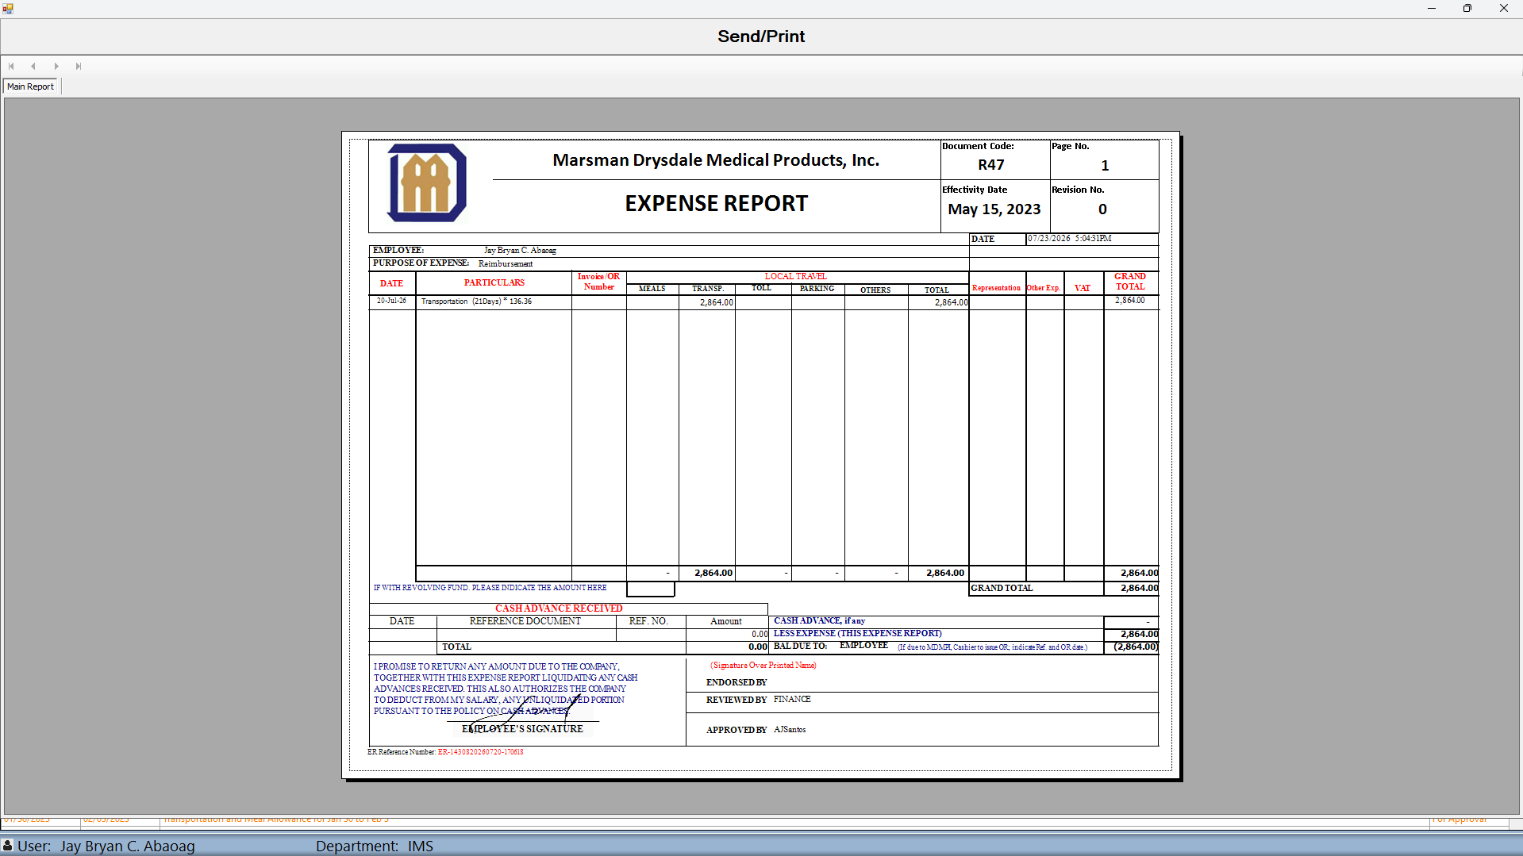
EMPLOYEE OR MANAGER
Send or print the completed expense report
WHAT TO DO
1
Preview the completed report.
2
Confirm the document and recipient context.
3
Use Send or Print as required.
12
Notes:
Review the completed report in the Send or Print window. Check the recipient or printer settings, then choose Send or Print as needed.

Slide 13
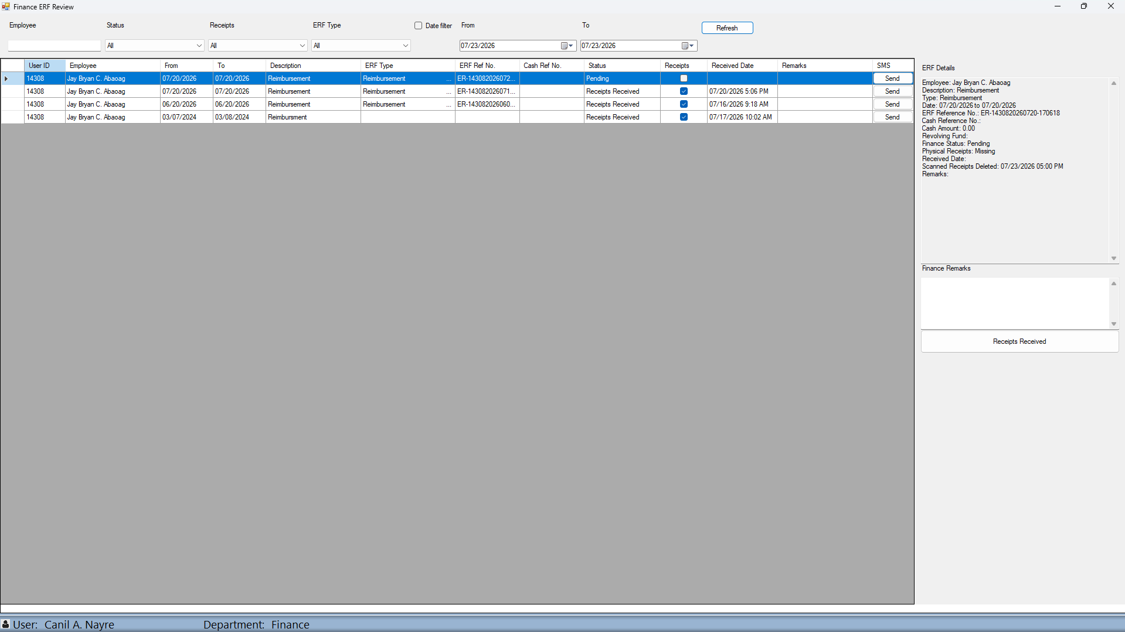
FINANCE
Finance verifies the submitted ERF and physical receipts
WHAT TO DO
1
Find and select the submitted ERF.
2
Review the ERF details, status, and receipt indicator.
3
Record remarks and confirm receipt handling.
13
Notes:
Finance selects the correct report and reviews its details and receipt status. Add a remark when needed. Click Receipts Received only after the physical receipts have been verified.

Slide 14
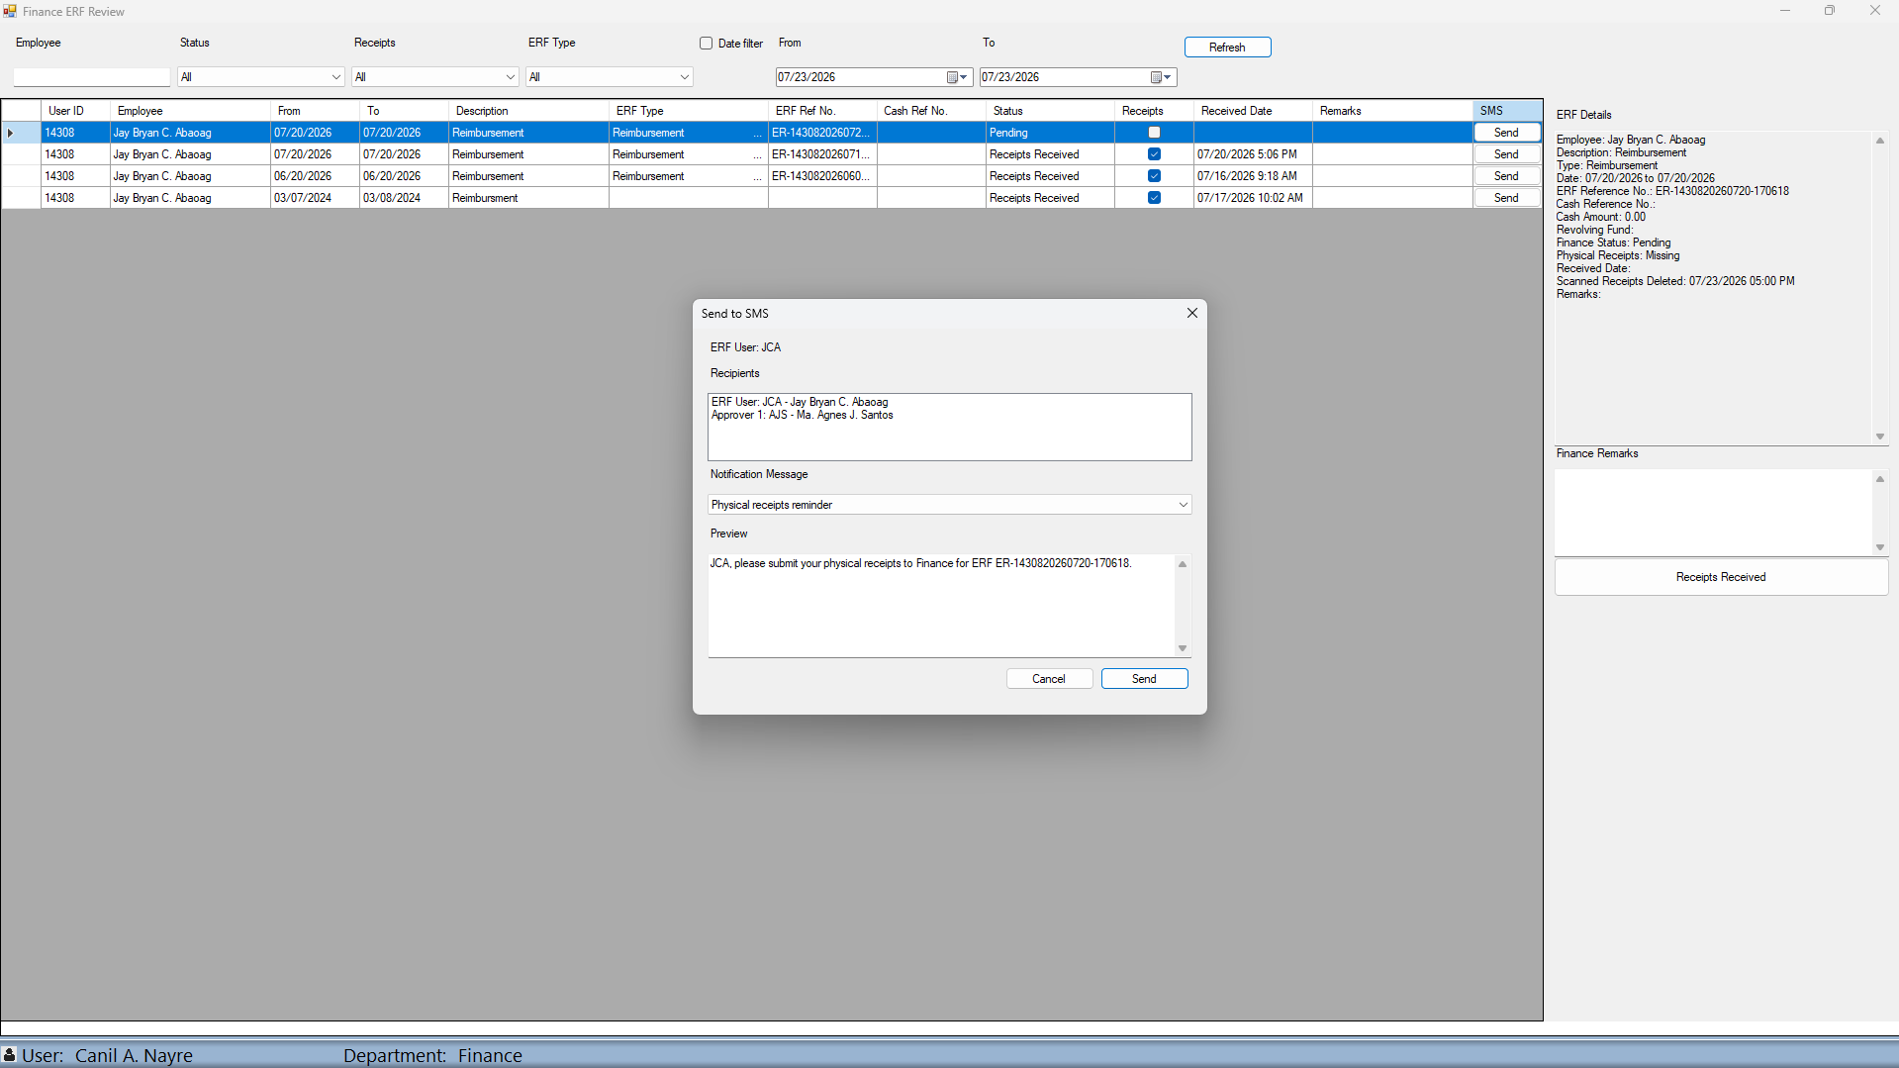
FINANCE
Finance sends SMS reminders from the review form
WHAT TO DO
1
Select Send in the report’s SMS column.
2
Verify the recipients and notification message.
3
Review the preview, then select Send.
14
Notes:
Click Send in the report’s SMS column. Check the recipients and preview the message. If everything is correct, click Send.

Slide 15
ROLES AND NEXT STEPS
Each role owns a clear part of the ERF process
EMPLOYEES
MANAGERS
BOTH ROLES
Maintain settings
Enter expenses
Review and file
Review submissions
Record decisions
Confirm the outcome
Check the final report
Send or print correctly
Follow current policy
Use this guide alongside your organization’s current expense policies.
15
15
Notes:
Employees create and file the report. Managers review and decide, while Finance verifies the report and receipts. Always check that you are working with the correct transaction.

